Slide 1

Remind.com
A great way to communicate with students!
Dr. Debbie Seacrest (they/them)
debbie.seacrest@umwestern.edu

Slide 2
Remind.com
App (iPhone/Android), texts, or email
Message individually, in groups, or as a class
Most responses go directly to instructor
  “Hi, all! Please remember to…”
  “Hi, you three! This is a group message, so responses will be seen by…”
  “Hi, Mack! I noticed that…”
You decide if students can message students

Slide 3
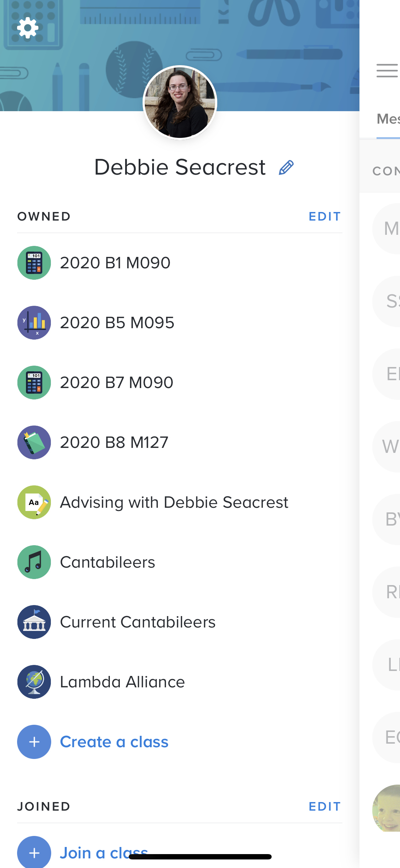
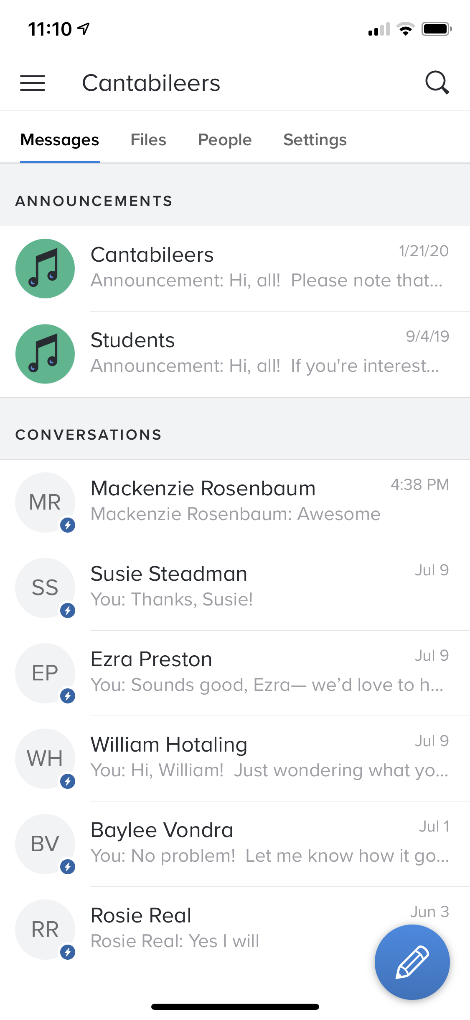
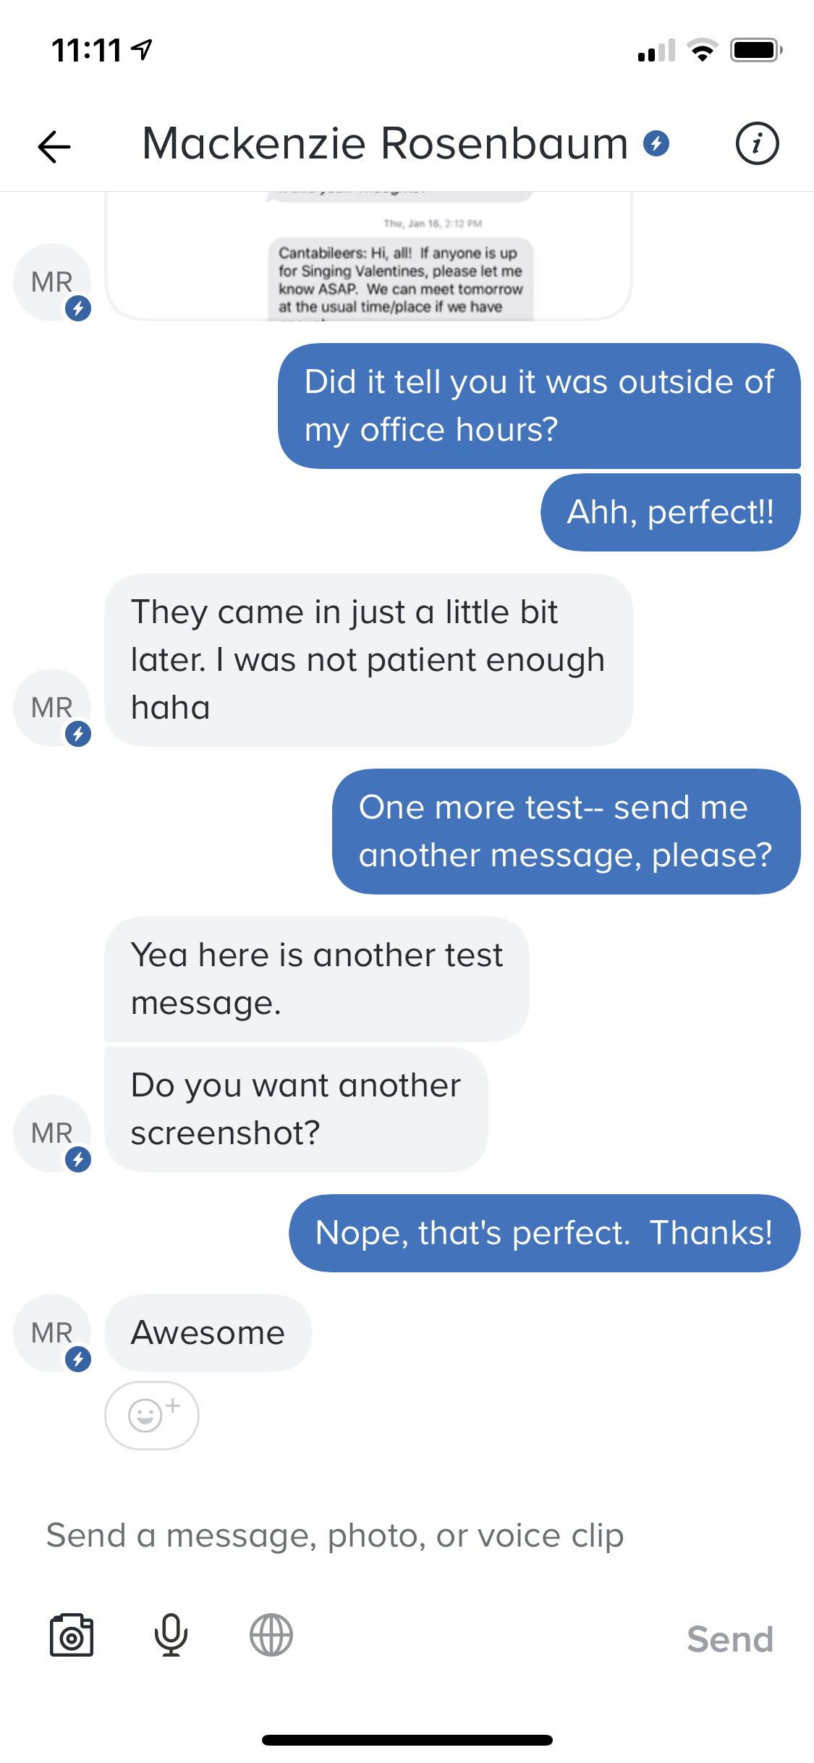

Slide 4
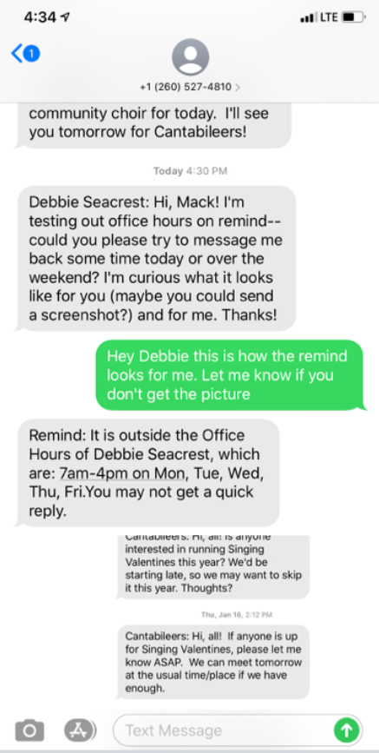
Notes:
CC: on board, on device, both?

Slide 5
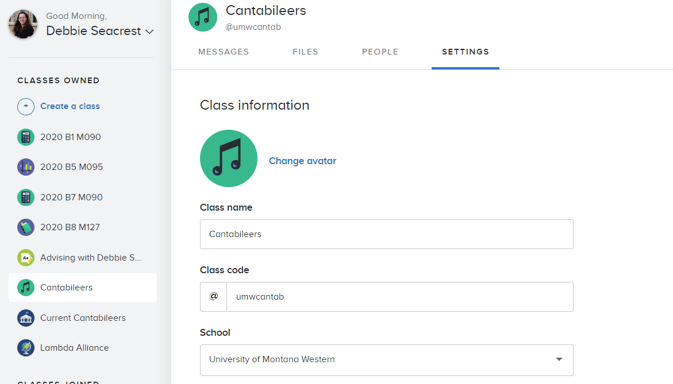

Slide 6
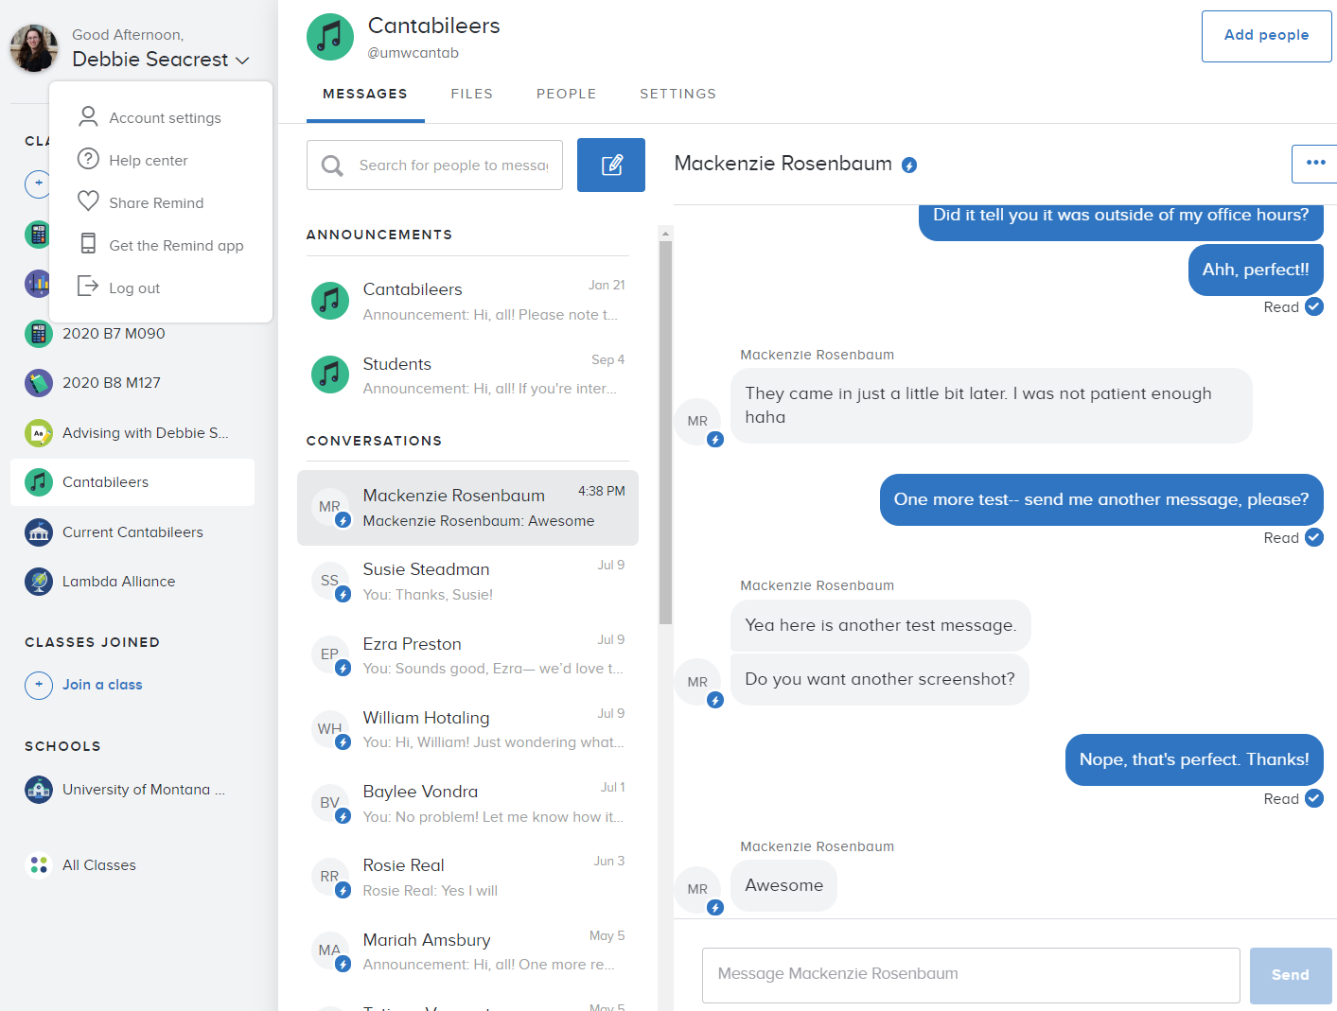

Slide 8
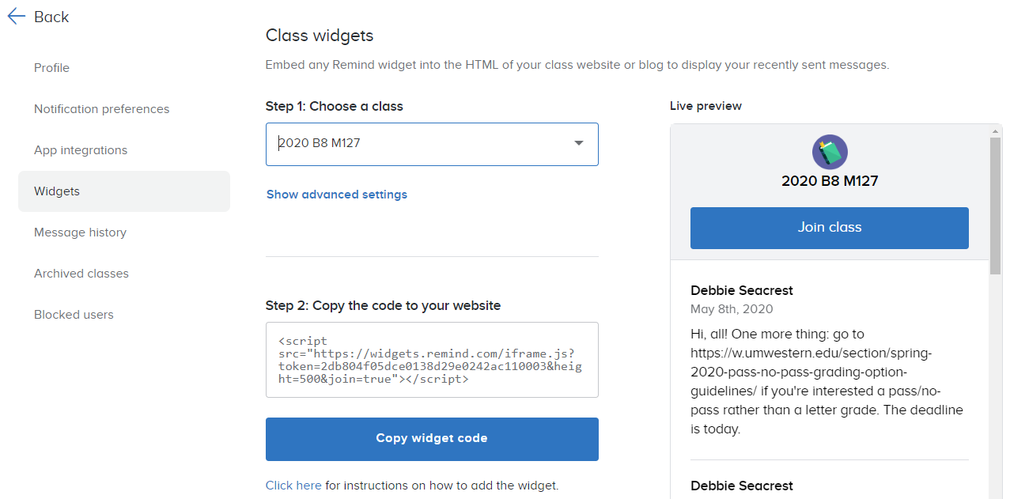

Slide 11
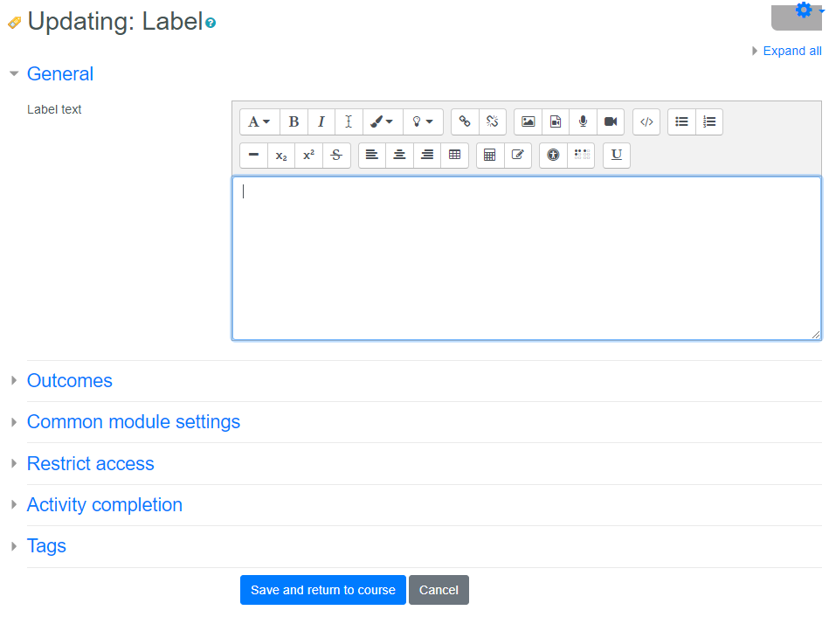

Slide 13
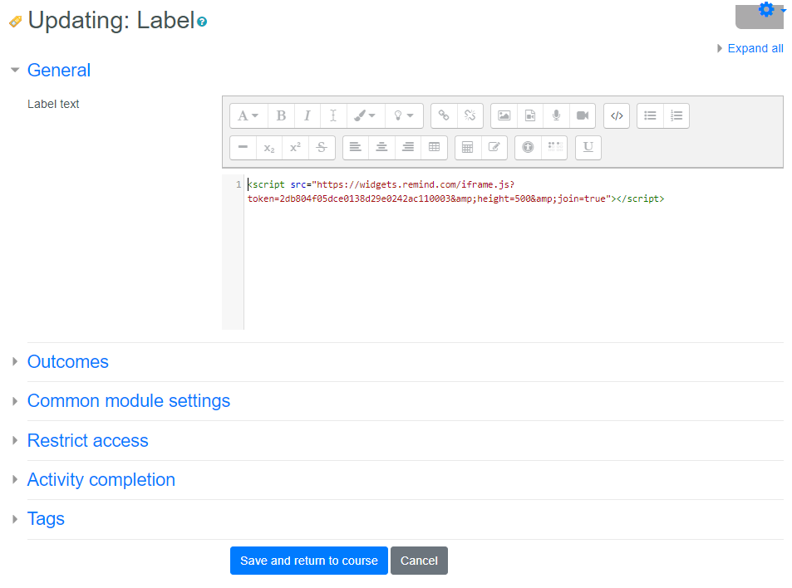

Slide 14
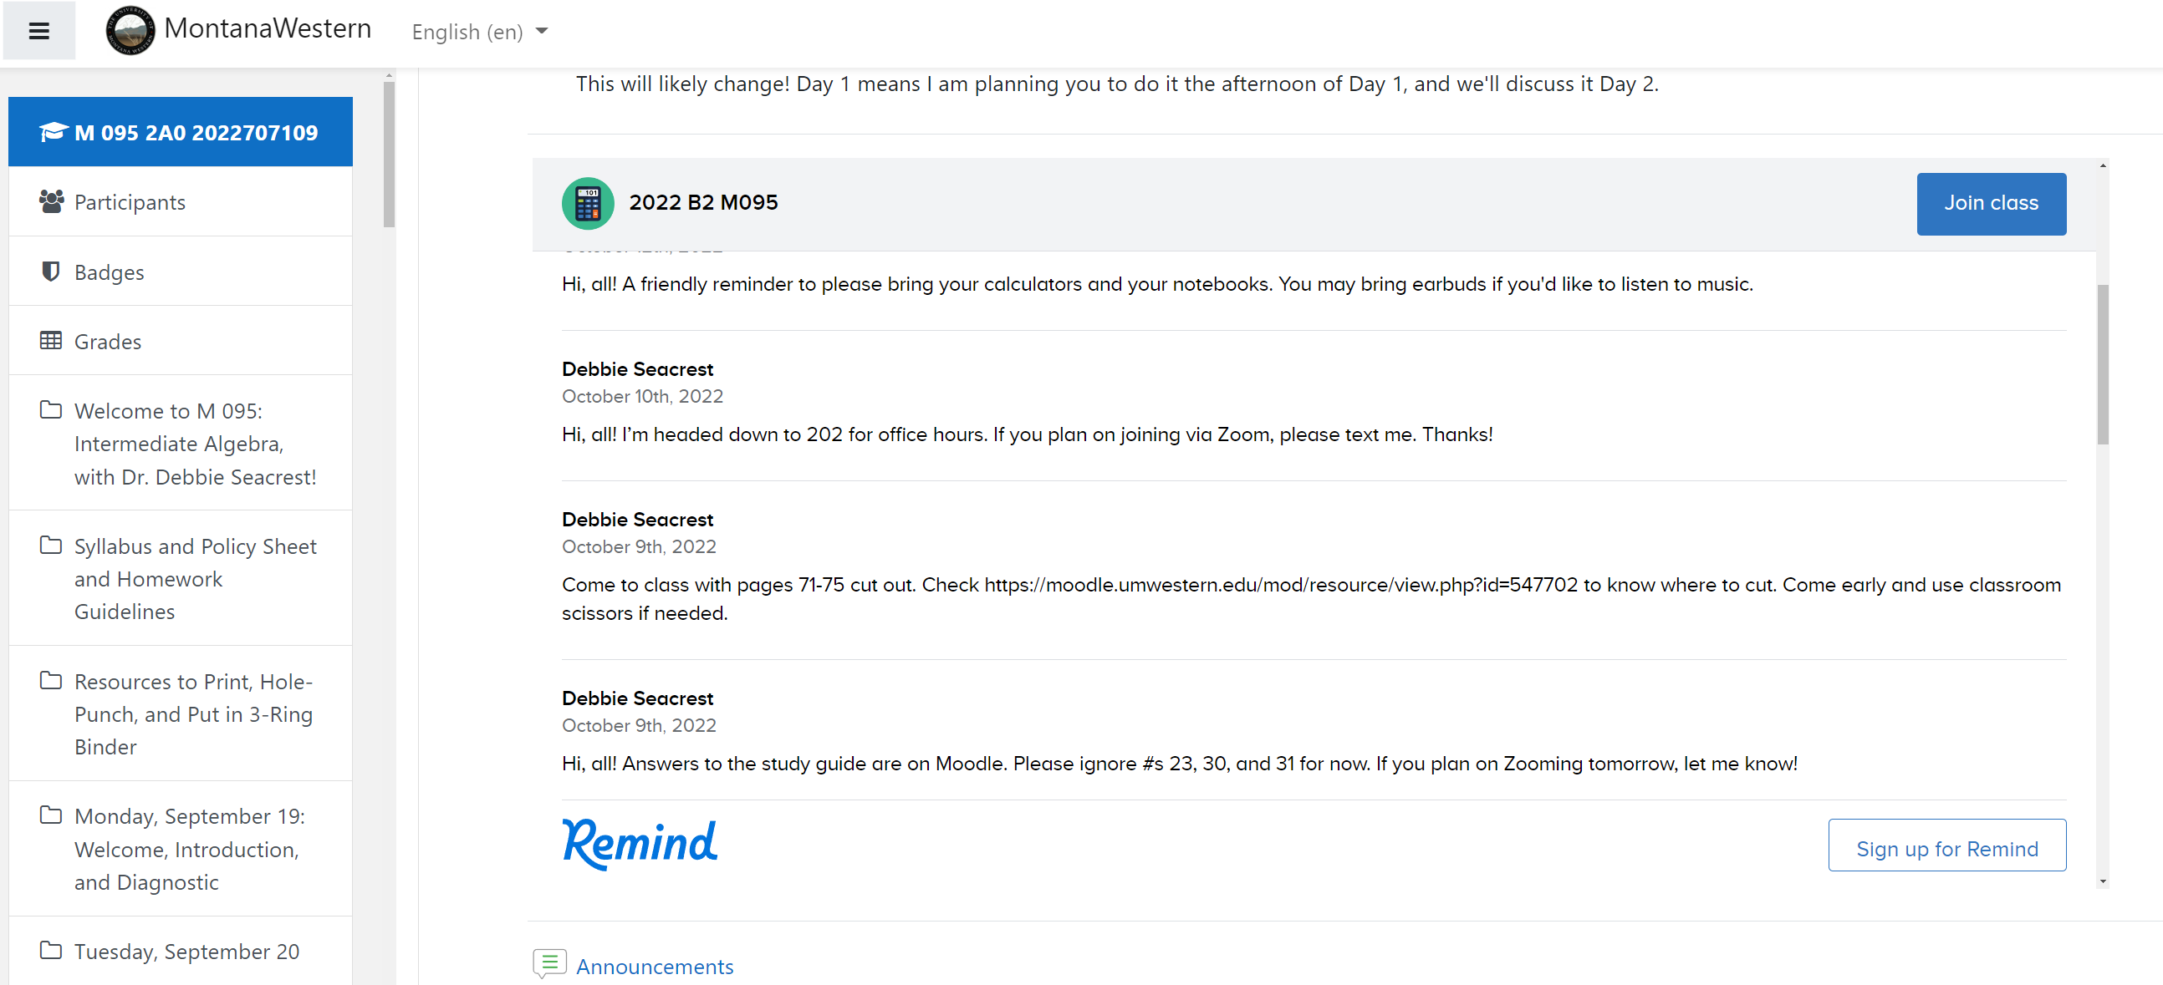

Slide 15
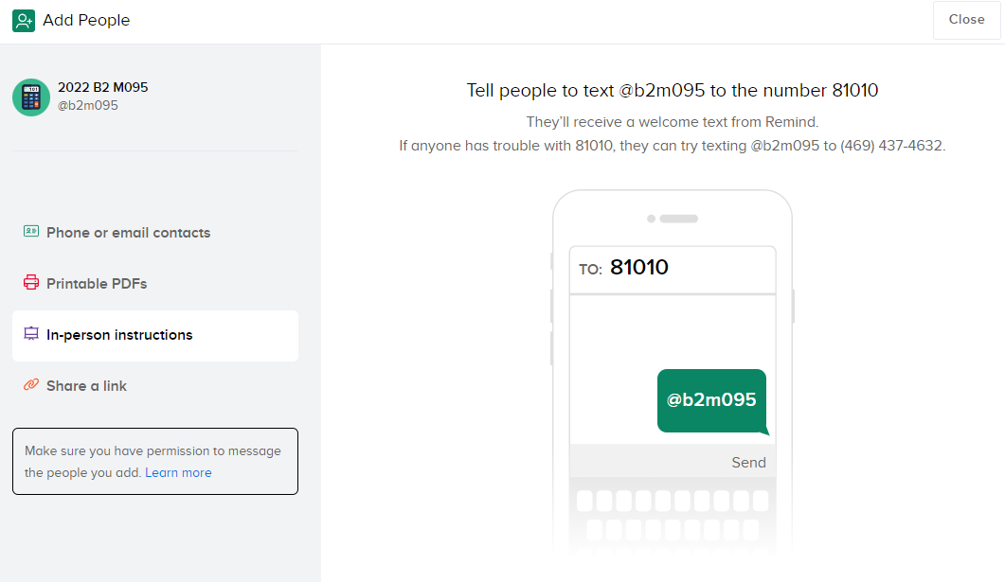

Slide 16
Unconventional Uses of Zoom:
Enhancing In-Person Classes
Dr. Debbie Seacrest (they/them)
debbie.seacrest@umwestern.edu

Slide 17

Disclaimer
Goals for Today:
Sharing ideas that worked for me
Discussing adaptations and ideas

Slide 18
Students with Specific In-Class Needs
Vision
  Zoom on own device (no audio connection) while in class
Notes:
CC: on board, on device, both?

Slide 19
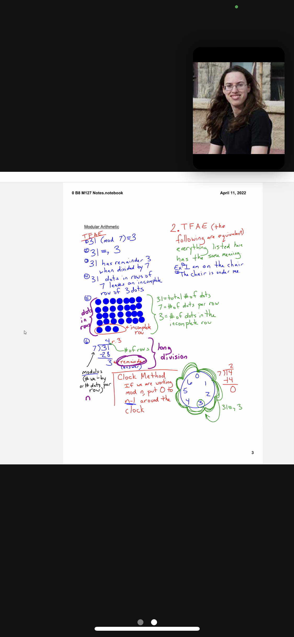
Zoom Visual Tips
Large font, bold, and high pen thickness
High-contrast
Non-distracting background
Camera angle
Could pause briefly to allow students to screenshot
Notes:
Students may be on phones or visually impaired

Slide 20

Programs Used on Zoom
.docx, .xlsx, .pptx
.pdf
SmartNotebook
Websites
Videos
ctrl- and ctrl= (think ctrl+)
Share sound, Optimize for video clip, mute self
Notes:
+ and – in Microsoft, ctrl- and ctrl= on websites (I think of = as +)

Slide 21
Students with Specific In-Class Needs
Vision
  Zoom on own device (no audio connection) while in class
Hearing
  Closed captioning
  Earbuds
Notes:
CC: on board, on device, both?

Slide 22
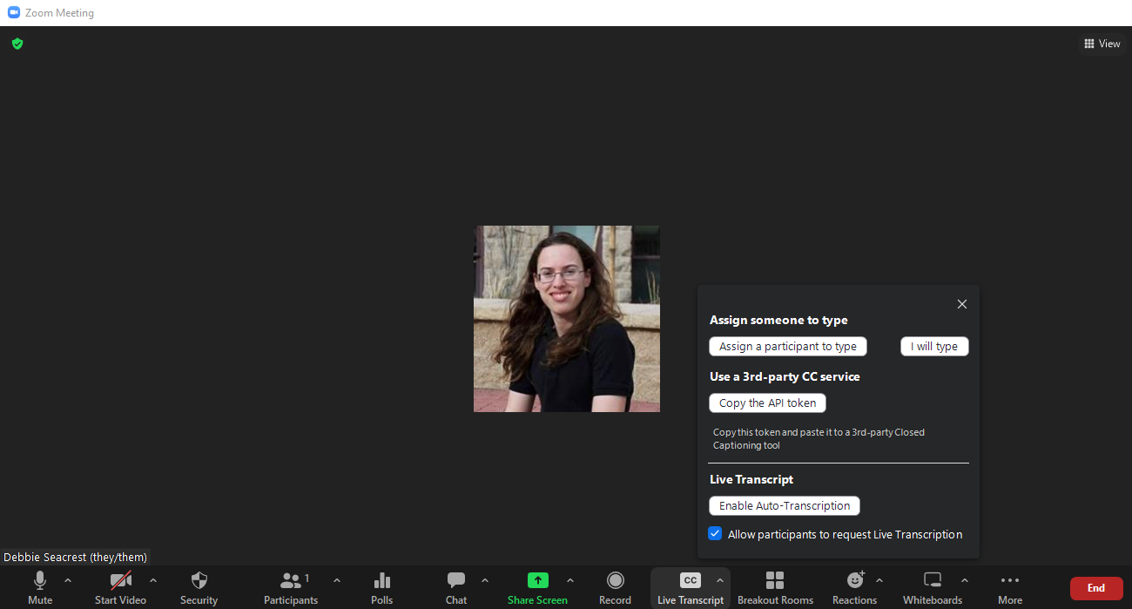

Closed-Captioning: Enable Auto-Transcription
Notes:
CC: on board, on device, both?

Slide 23
Closed-Captioning: Enable Auto-Transcription
Notes:
CC: on board, on device, both?

Slide 24
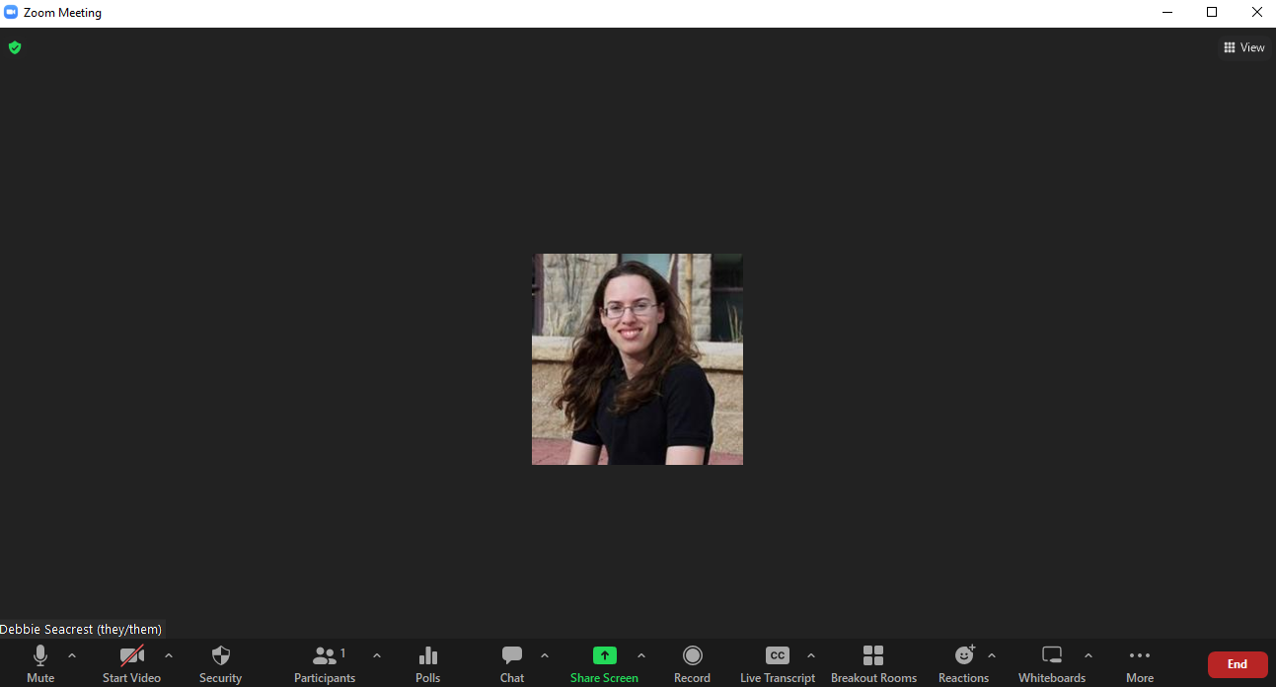
Closed-Captioning: Adding Transcription Pane
Notes:
CC: on board, on device, both?

Slide 25
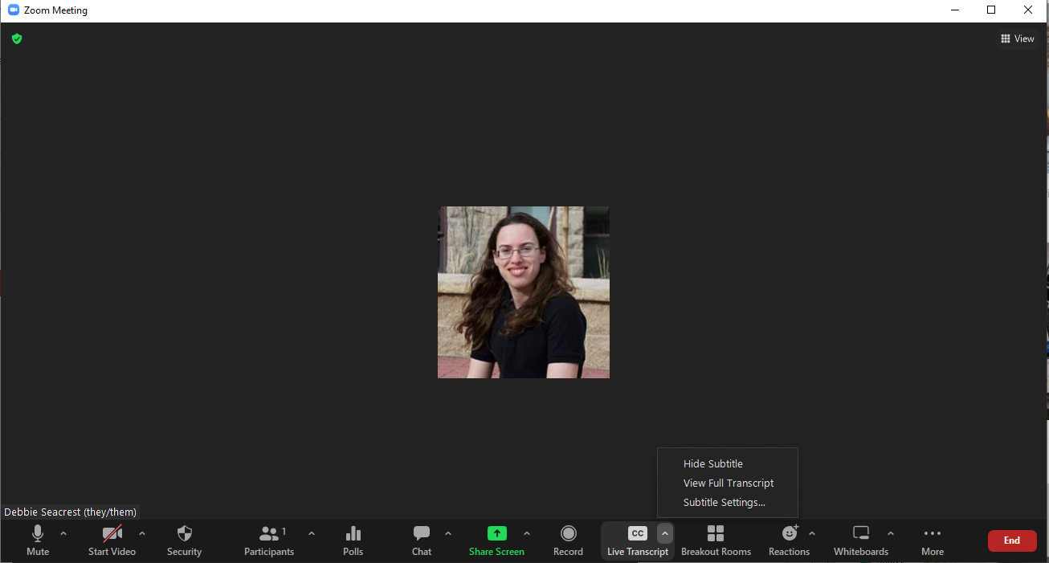
Closed-Captioning: Adding Transcription Pane
Notes:
CC: on board, on device, both?

Slide 26
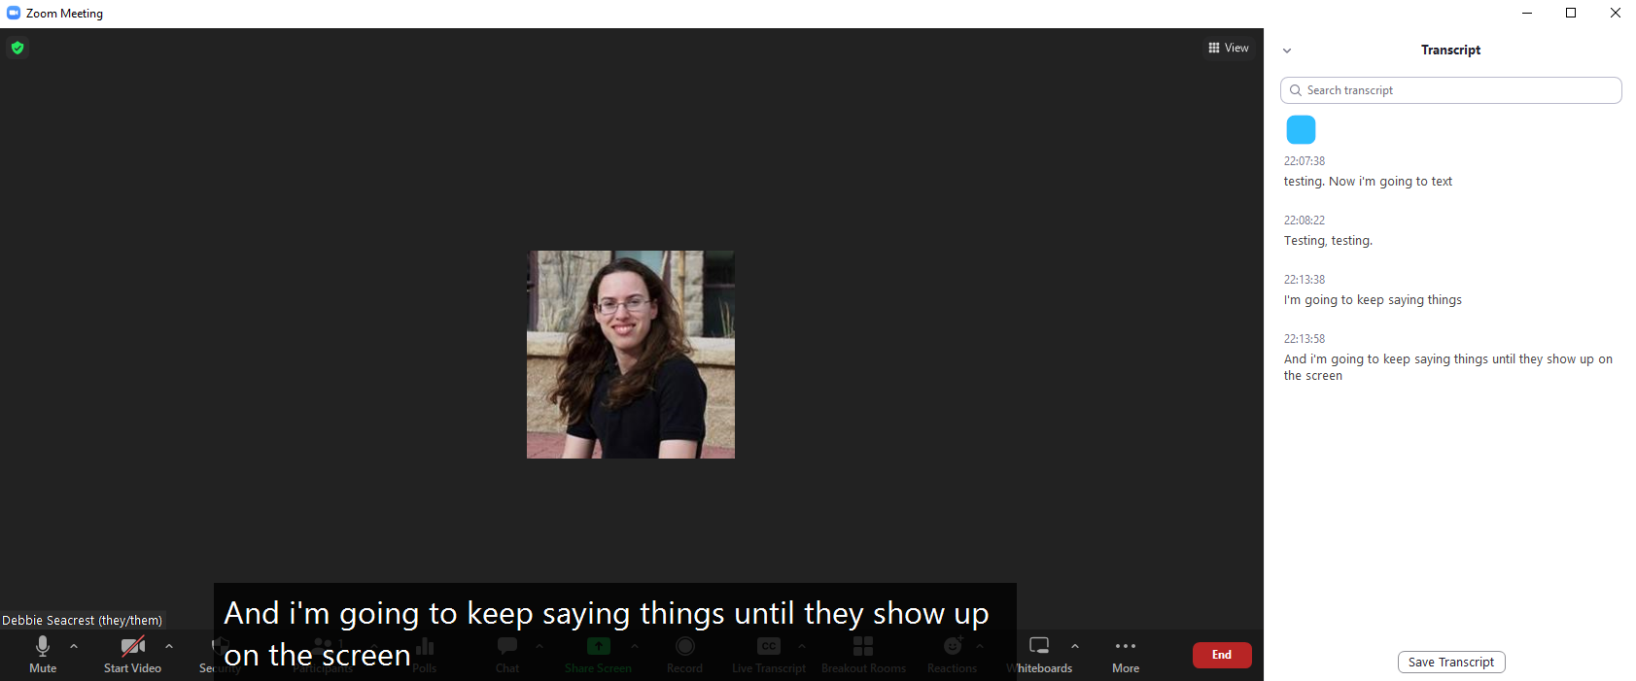
Closed-Captioning: Transcription Pane
Notes:
CC: on board, on device, both?

Slide 27
Tips for Programs Used on Zoom
Ask Zoom students to tell you if things don’t show up or can’t be heard!
Notes:
For that matter, ask in-person (SmartBoard)

Slide 28
Tips for Programs Used on Zoom
Ask all students to tell you if things don’t show up or can’t be heard!
www.xkcd.com/832 (snip and paste)
Write on the screen rather than pointing
If you can see chat, it can be seen on the SmartBoard
  Work-arounds: other programs, anonymity, small font, second screen just for you
Notes:
For that matter, ask in-person (SmartBoard)

Slide 29
“Standard” Benefits of Zoom
Remote Attendance
  Sick/disabled
  Icy roads
  Out of town (family emergency, medical appointment)

Slide 30
Benefits of Zoom Recordings
Students can watch or re-watch class
  Can watch if unable to attend
  Can pause to experiment/verify
  Can re-watch with more prior knowledge
Notes:
Yes, it is obvious!
Need to watch the entire movie again

Slide 31
Benefits of Sharing Boardwork PDFs
Many students qualify (or would qualify) for note-taking services
Universal Design
  Students don’t need to “out” themselves
  Students don’t feel “othered” or like an inconvenience
Can prioritize understanding over note-taking

Slide 32
Students who Might Benefit from Boardwork PDFs
Physical disabilities, dysgraphia
  Permanent or temporary
Difficulty multi-tasking
Hearing or vision difficulties
  Visual processing disorder
Notes:
Temporary = hard to get accommodations,

Slide 33
Combining Recordings and Boardwork PDFs
Spoken and written modalities
Less pressure for me to say/write everything
Less pressure for them to write everything
Gives “forgiveness” for attention wandering

Slide 34
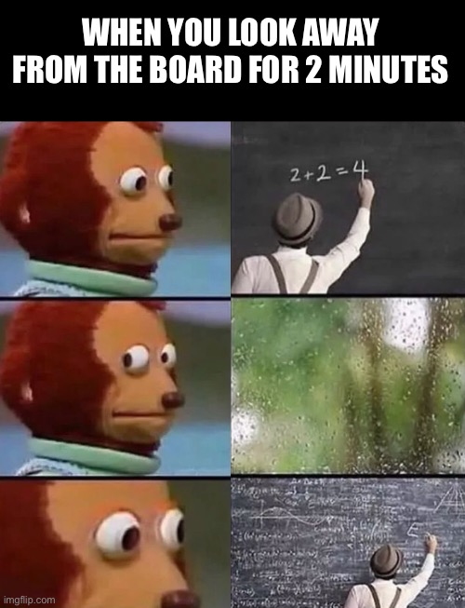
https://imgflip.com/i/6dxhs1

Slide 35
Things to Keep in Mind
You can now share a screen with all Breakout Rooms
Share screen switcher can show sensitive information
Notes:
Can restrict emojis

Slide 36
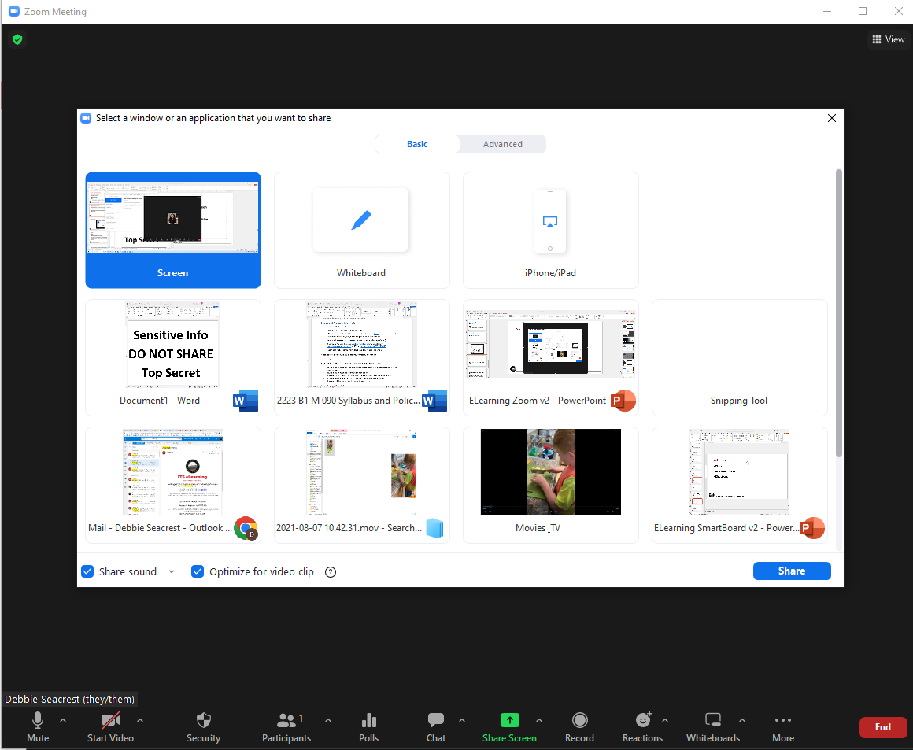
Notes:
Sensitive- Emails, titles, etc.

Slide 37
Things to Keep in Mind
You can now share a screen with all Breakout Rooms
Share screen switcher can show sensitive information
Share iPhone/iPad screen can show sensitive info
Notes:
Can restrict emojis

Slide 38
Notes:
Sensitive- Emails, titles, etc.

Slide 39
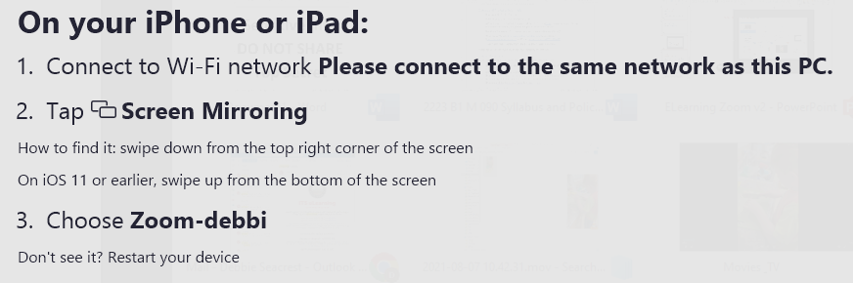
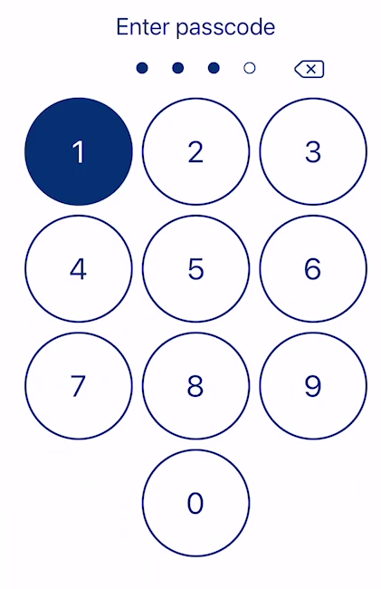
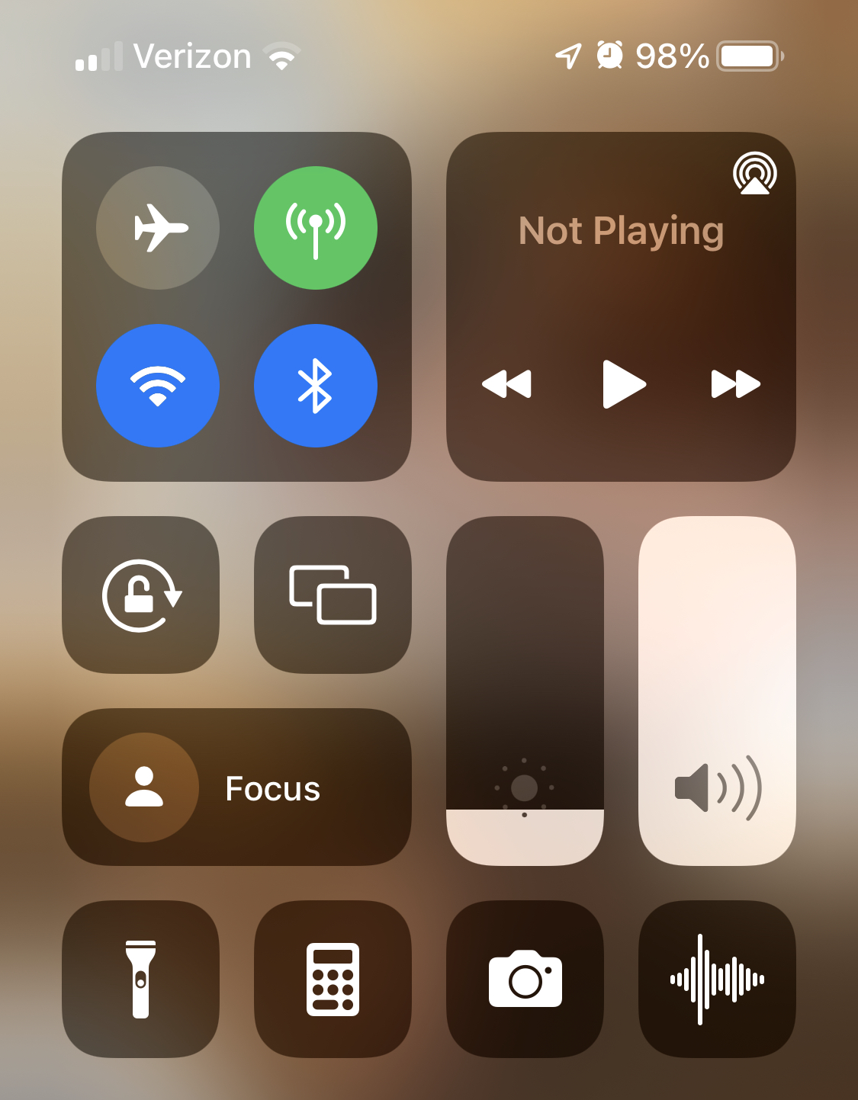
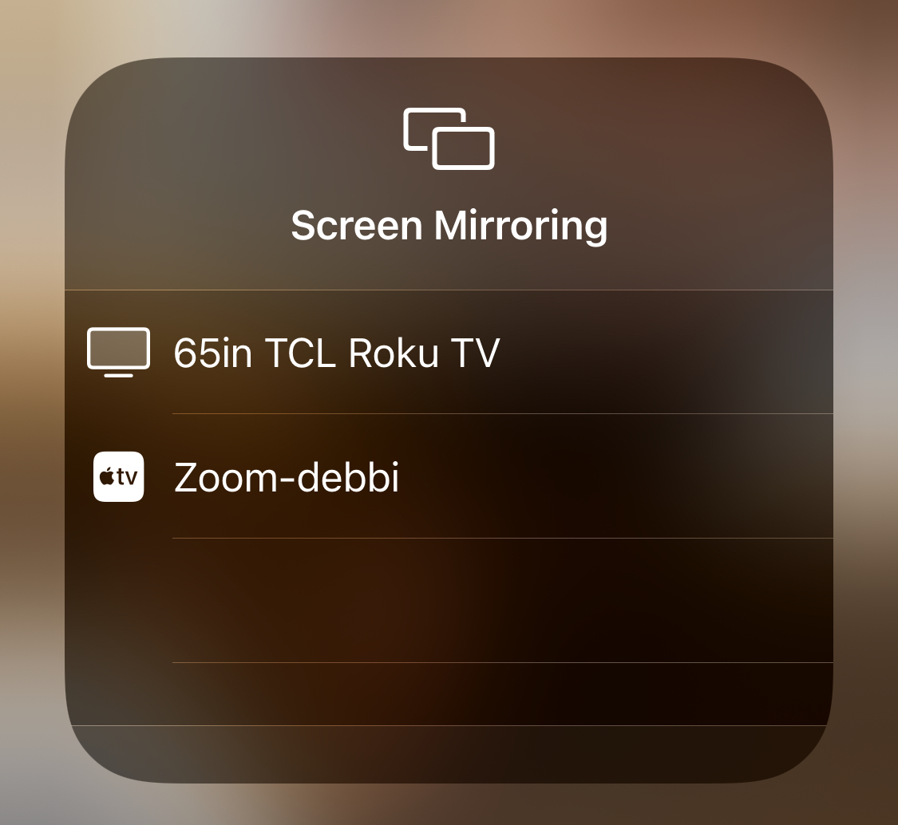
Notes:
Sensitive- Emails, titles, etc.

Slide 40
Things to Keep in Mind
You can now share a screen with all Breakout Rooms
Share screen switcher can show sensitive information
Share iPhone/iPad screen can show sensitive info
On videos, click “Share sound” and “Optimize for video clip”
Notes:
Can restrict emojis

Slide 41
Notes:
Sensitive- Emails, titles, etc.

Slide 42
Videos
Windows Media Player is choppy
YouTube, VLC, and Movies & TV all seem good
Netflix, Amazon Prime, etc. can show video as black
  Check copyright issues if needed
  Share easily on Apple devices
Notes:
Ask student to share

Slide 43
Zoom Meetings
Personal Link for Meeting ID
Set up on web: https://zoom.us/profile
Notes:
Text instead of numbers (why??)

Slide 44
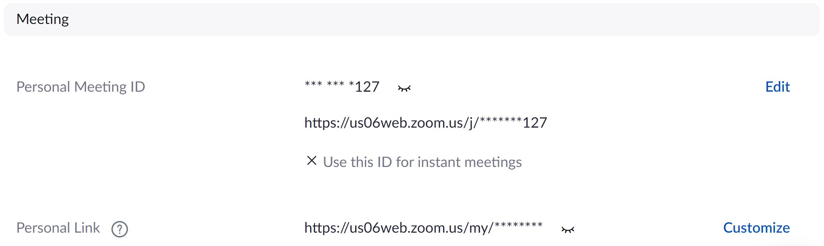
https://zoom.us/my/dseacrest
Notes:
Can leave out the us06web

Slide 45
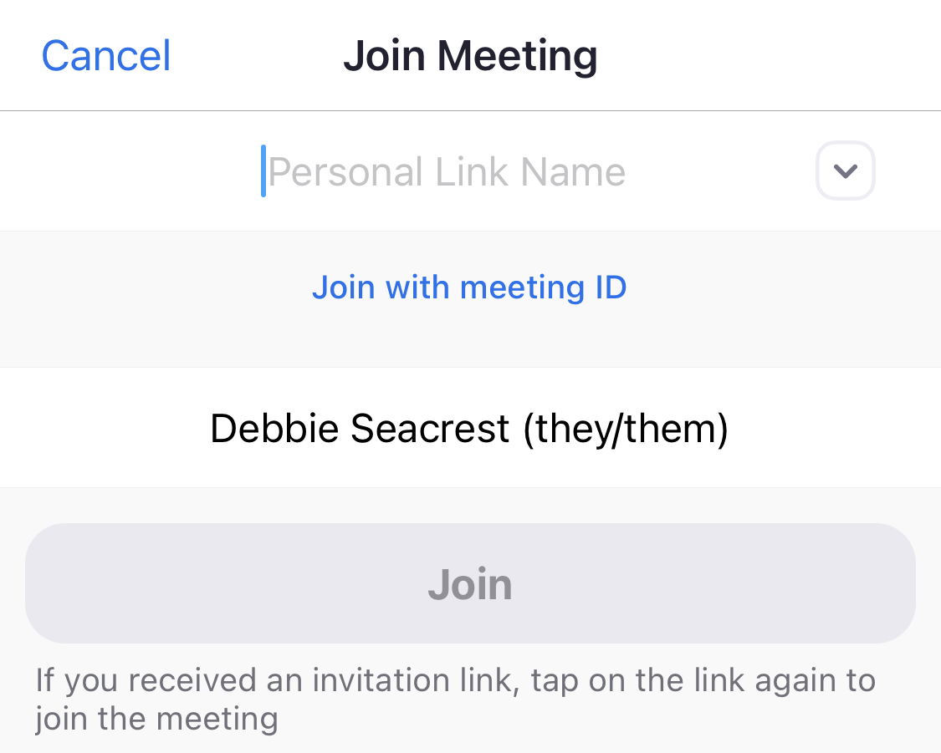
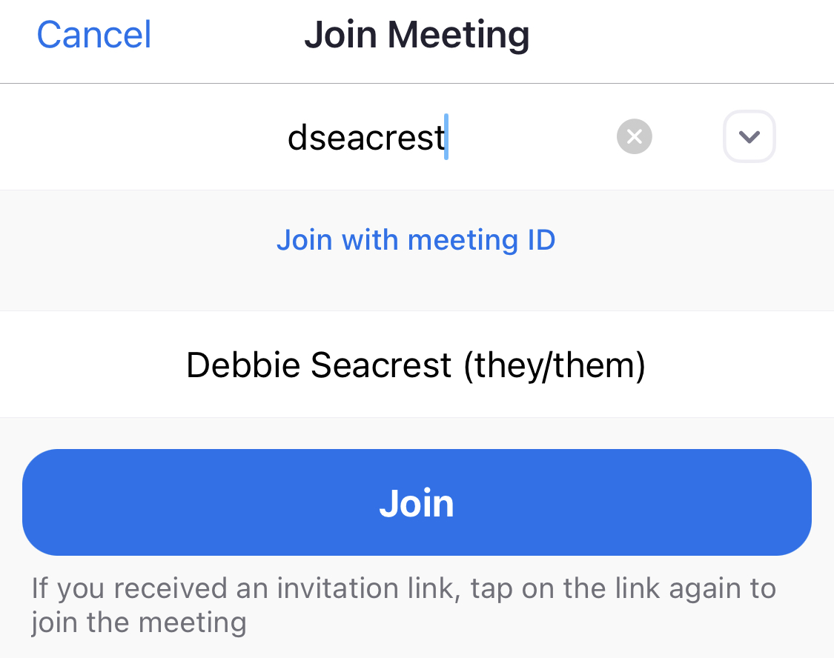
Notes:
Text instead of numbers (why??)

Slide 46
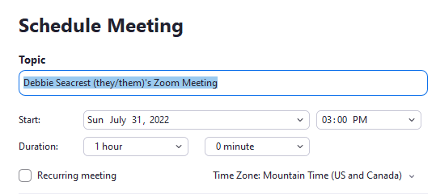
Notes:
Text instead of numbers (why??)

Slide 47
Nuts and Bolts of What Works for Me
Join Zoom anytime, no waiting room, computer audio only
Notes:
Students can slip note under my door, etc.

Slide 48
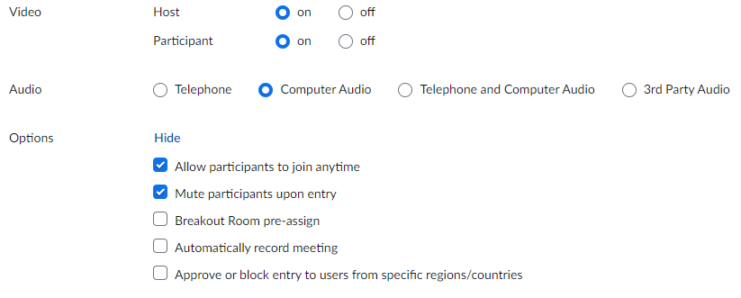
Notes:
Can leave out the us06web

Slide 49
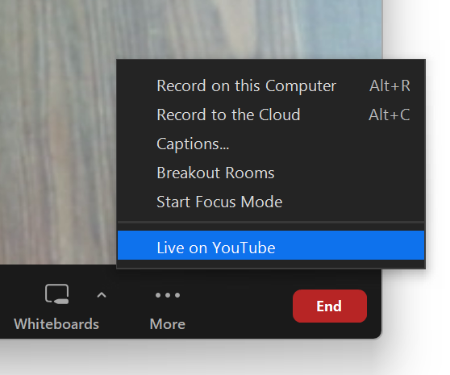
YouTube Live

Slide 50
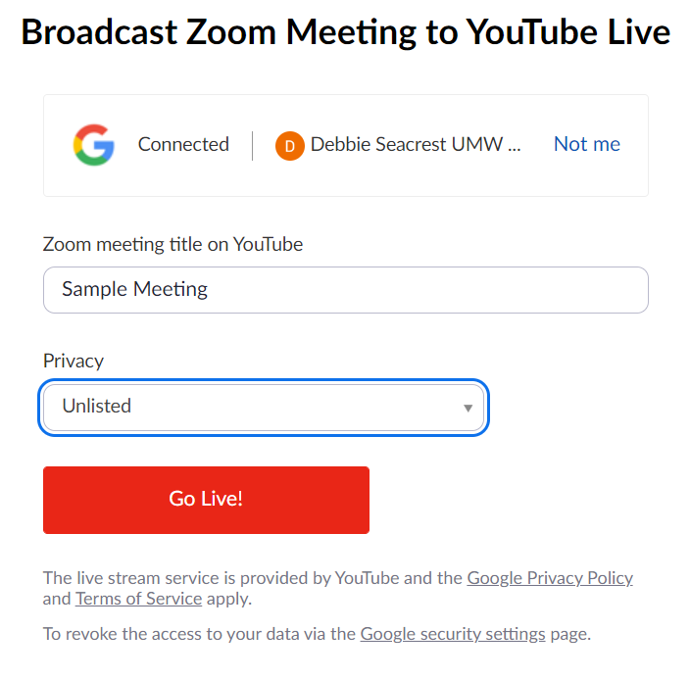
YouTube Live

Slide 51
YouTube Live
Live on YouTube

Slide 52
Nuts and Bolts of What Works for Me
Join Zoom anytime, no waiting room, computer audio only
Open chat, give disclaimer, ask students to point out chats
Camera on me, SmartBoard screen shared, area mic
Second screen for chat (iPad)
Record to computer, let process
YouTube playlist (unlisted), can close after uploading is done
Give playlist link on Moodle (don’t need to update)
Export notes as PDF and post on Moodle (update daily)
Notes:
Students can slip note under my door, etc.

Slide 53
Questions or Thoughts?
debbie.seacrest@umwestern.edu

